Slide 1

Investor Update
Fourth Quarter ~ Fiscal Year 2021

Slide 2
Forward-looking Statements / Non-GAAP
This presentation contains forward-looking statements within the meaning of the Private Securities Litigation Reform Act of 1995. Forward-looking statements are based upon management’s current expectations and are subject to various risks and uncertainties including, but not limited to: The ability of the Company to stabilize and grow revenues; The acceptance of, and renewal rates for our subscription offerings, including the All Access Pass and Leader in Me memberships; The duration and recovery from the COVID-19 pandemic; The ability of the Company to hire productive sales professionals; General economic conditions; Competition in the Company’s targeted marketplace; Market acceptance of new offerings or services and marketing strategies; Changes in the Company’s market share; Changes in the size of the overall market for the Company’s products; Changes in the training and spending policies of the Company’s clients, and other factors identified and discussed in the Company’s most recent Annual Report on From 10-K and other periodic reports filed with the Securities and Exchange Commission. Many of these conditions are beyond our control or influence, any one of which may cause future results to differ materially from the Company’s current expectations, and there can be no assurance the Company’s actual future performance will meet management’s expectations. These forward-looking statements are based on management’s current expectations and we undertake no obligation to update or revise these forward-looking statements to reflect events or circumstances after the date of today’s presentation, except as required by law.
The Securities and Exchange Commission’s Regulation G applies to any public disclosure or release of material information that includes a non-GAAP financial measure. In the event of such a disclosure or release, Regulation G requires: (i) the presentation of the most directly comparable financial measure calculated and presented in accordance with GAAP and (ii) a reconciliation of the differences between the non-GAAP financial measure presented and the most directly comparable financial measure calculated and presented in accordance with GAAP. The required presentations and reconciliations are contained herein and can be found at our website at www.franklincovey.com.
Franklin Covey uses the non-GAAP financial measure “earnings before interest, taxes, depreciation and amortization” (“EBITDA”) to assess the operating results and effectiveness of the Company’s ongoing training and consulting business. In addition, the Company also uses the non-GAAP financial measure “Adjusted EBITDA” as a representation of the Company’s operating performance. Adjusted EBITDA is defined as pre-tax net income (loss), plus depreciation and amortization, net interest income (expense), and special charges, such as the gain on the sale of the Japan Products division in Fiscal 2010, restructuring costs, and asset impairment changes. The Company finds these non-GAAP financial measures to be useful when evaluating its operating and financial performance. These non-GAAP financial measures may not be comparable to similar measures used by other companies and should not be used as a substitute for revenue, net income (loss) or other GAAP operating measures.

Slide 3
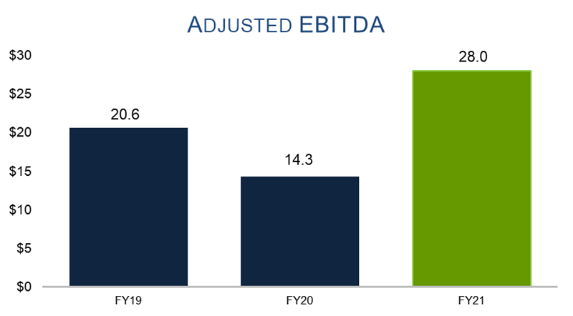
Franklin Covey: Strong Growth in Adjusted EBITDA
(in millions and unaudited)

Slide 4
Strong Growth in Key Metrics
Total Revenue Up 13% in FY21
Total Revenue Up 41% in Q4
Total Subscription Revenue
Up 15% in FY21
Total Subscription Revenue
Up 33% in Q4
Total Subscription & Subscription Services Revenue
Up 21% in FY21
Total Subscription & Subscription Services Revenue
Up 52% in Q4
Sum Billed & Unbilled Deferred Revenue Up 27% in FY21

Slide 5
Key Takeaways
Strong fourth quarter and fiscal year results
Driven by strength of subscription business model
We Address clients most important challenges
Subscription & subscription services to account for >90% of sales
Continue to drive additional value to shareholders

Slide 6
Key Takeaways
Strong fourth quarter and fiscal year results
Driven by strength of subscription business model
We Address clients most important challenges
Subscription & subscription services to account for >90% of sales
Continue to drive additional value to shareholders

Slide 7
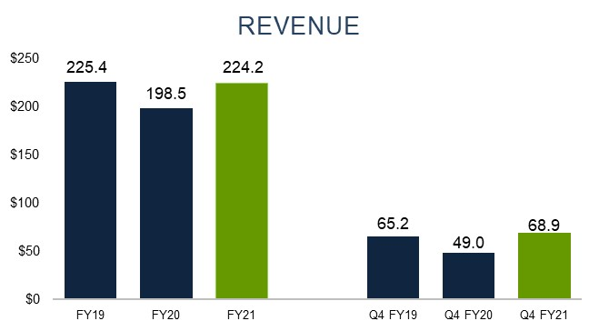
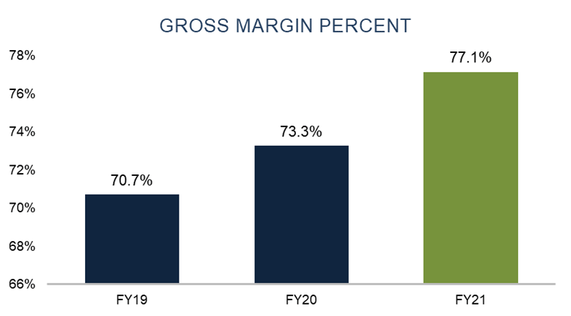
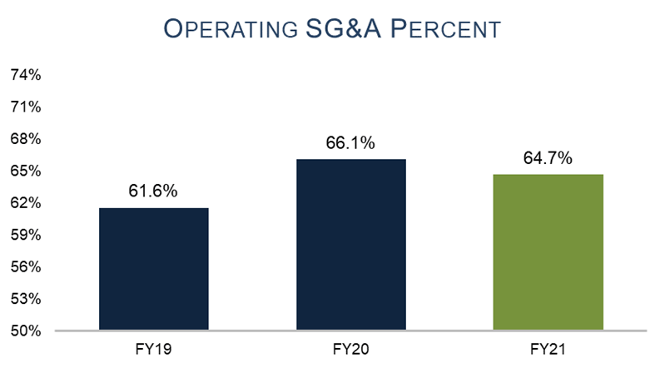
Franklin Covey: Highlights
(in millions and unaudited)

Slide 8
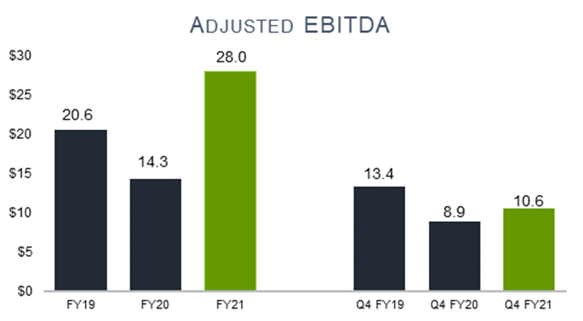
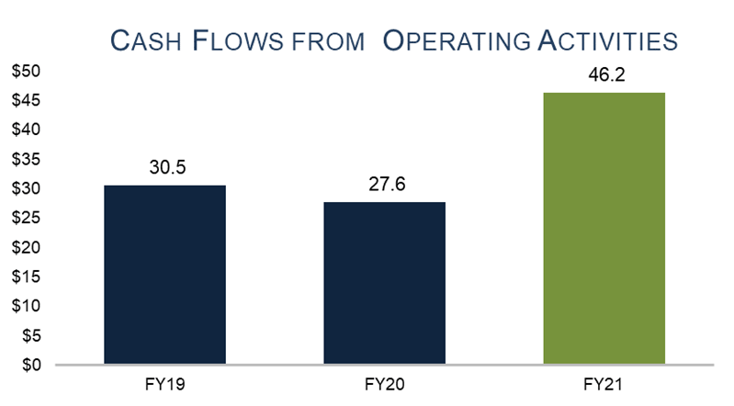
Franklin Covey: Highlights
(in millions and unaudited)

Slide 9
Franklin Covey – Financial Summary
(in millions and unaudited)
Note: Adjusted EBITDA and Operating SG&A are non-GAAP financial measures; please see Appendix for additional information. Amounts may not total due to rounding.

Slide 10
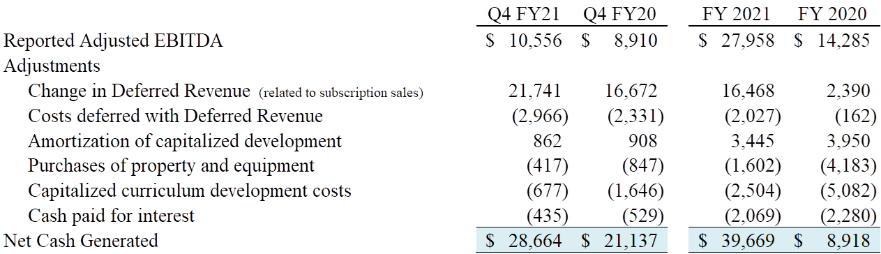
Net Cash Generated
(in thousands and unaudited)
Notes:
Net Cash Generated is a measure used by management to monitor the amount of available cash generated by the operations of the company. Net Cash Generated includes the items listed above and excludes other cash activities shown on the Consolidated Statements of Cash Flows, such as cash paid for taxes, acquisitions, changes in working capital, other SG&A, and payments on term notes and financing obligations.
Please refer to the Appendix for the definition of Adjusted EBITDA and for the reconciliation of Adjusted EBITDA to Net Income.
Please also refer to the Condensed Consolidated Statements of Cash Flows.

Slide 11
Cash Flows from Operating Activities
(in thousands and unaudited)

Slide 12
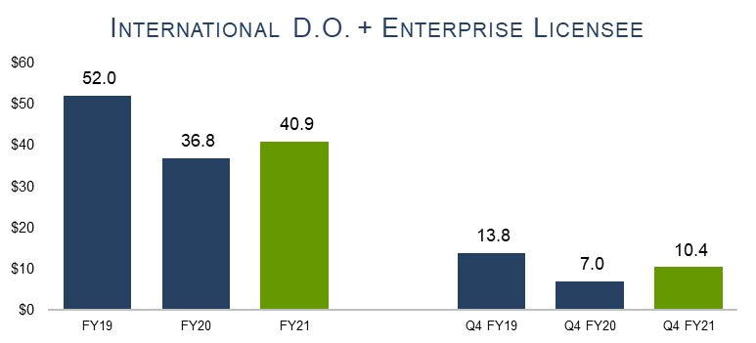
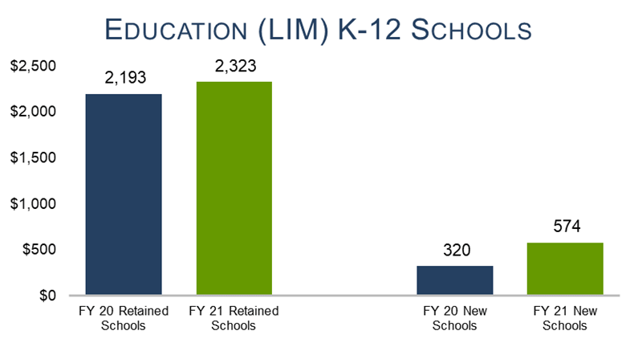
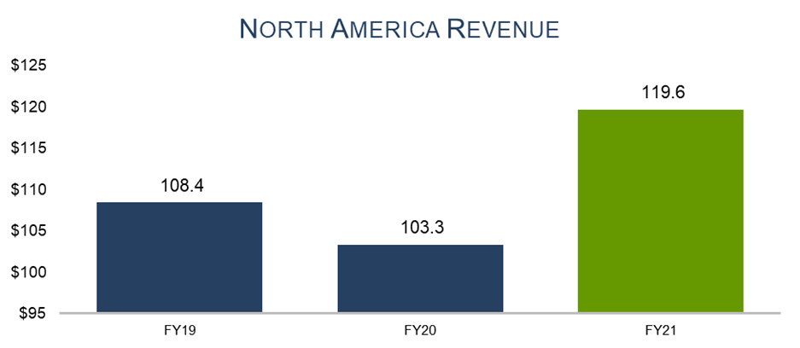
Franklin Covey: Highlights
(in millions and unaudited)
Note: this chart shows the number of new Leader in Me schools who contracted by the end of the 4th quarter.

Slide 13
Key Takeaways
Strong fourth quarter and fiscal year results
Driven by strength of subscription business model
We Address clients most important challenges
Subscription & subscription services to account for >90% of sales
Continue to drive additional value to shareholders

Slide 14
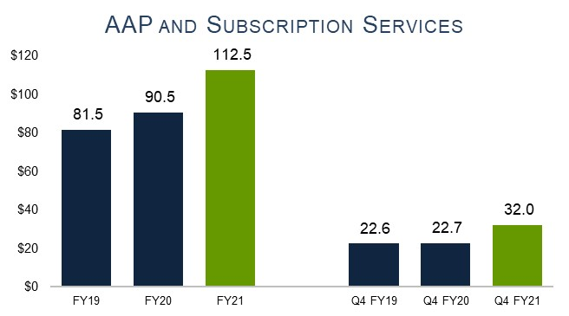
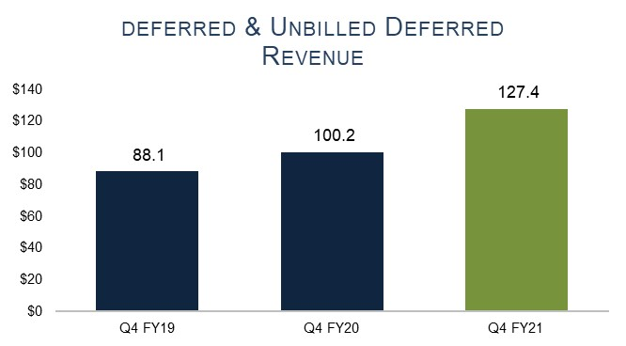
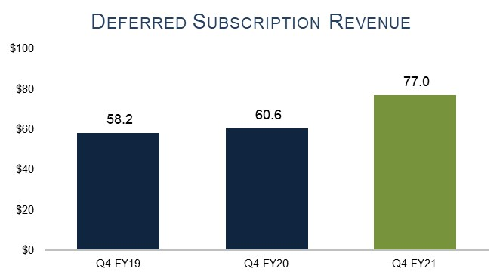
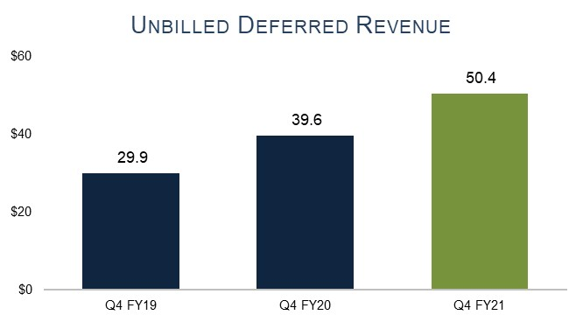
Franklin Covey: Strength of Subscription Business Model
(in millions and unaudited)

Slide 15
Enterprise: All Access Pass Subscription Services Increases
(in millions and unaudited)

Slide 16
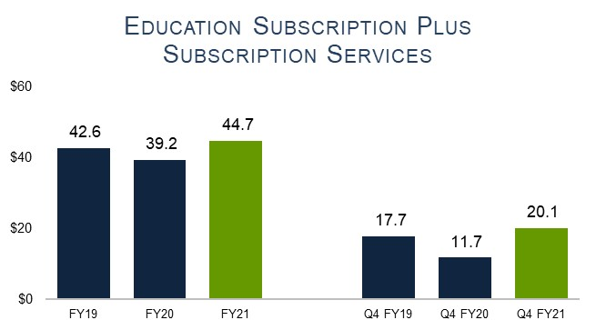
Education: Leader in Me Subscription Services Increases
(in millions and unaudited)

Slide 17
Key Takeaways
Strong fourth quarter and fiscal year results
Driven by strength of subscription business model
We Address clients most important challenges
Subscription & subscription services to account for >90% of sales
Continue to drive additional value to shareholders

Slide 18

It’s clear that not all offerings generate equal levels of organizational impact
Individual access
to information on
a variety of personal topics
Individual
skills and capabilities
applied to the workplace
Collective behavior change
against must-win
organizational objectives
Benefits individuals
Benefits individuals
and organizations

Slide 19
Lifetime Customer Value Has Increased Significantly
Average AAP
(pass only) Price is Approx. $42K
Multi-Year Progress
41% of Contracts
53% of Revenue
>$42K
High Blended Gross Margins driving high and increasing company Gross Margins*
>85%
>90%
Annual Recurring Revenue Retention has always been >90%
52%
Services Attachment Rate has increased to 52%
(U.S./Canada/Government—August 31, 2021)
*Enterprise Division Gross Margin - Blend between Subscription & Services

Slide 20
Key Takeaways
Strong fourth quarter and fiscal year results
Driven by strength of subscription business model
We Address clients most important challenges
Subscription & subscription services to account for >90% of sales
Continue to drive additional value to shareholders

Slide 21
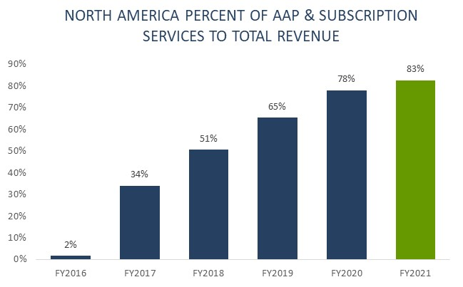
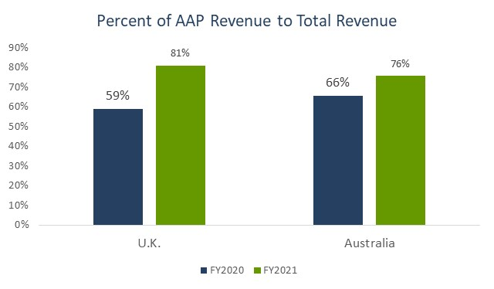
Enterprise

Slide 22
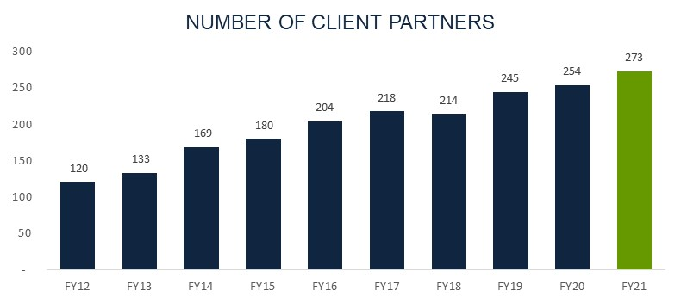
Number of Client Partners

Slide 23
Growing Investments

Slide 24
Key Takeaways
Strong fourth quarter and fiscal year results
Driven by strength of subscription business model
We Address clients most important challenges
Subscription & subscription services to account for >90% of sales
Continue to drive additional value to shareholders

Slide 25

Targets
2024
Reported Adj EBITDA: $54-56M
2023
Reported Adj EBITDA: $44-46M
2022
Reported Adj EBITDA: $34-36M
2021
Reported Adj EBITDA: $28M
Note: Adjusted EBITDA and Operating SG&A are non-GAAP financial measures. Please see the appendix for additional information.

Slide 26
Appendix

Slide 27
Other Information
Other Income Statement Information:
Depreciation: $6.2M in FY2021, expected to total approximately $5.8M in FY2022.
Amortization: $5.0M in FY2021, expected to total approximately $5.3M in FY2022.
Net Interest and Discount: $2.0M in FY2021, expected to total approximately $1.8M in FY2022.
Share-based Compensation, Impaired Assets, Restructuring, Accrued Earnout and Other totaling $8.7M in FY2021; expected to total approximately $9.6M in FY2022.
Effective Tax Rate: Our normalized affective tax rate is expected to eventually be 26% to 30%, before unusual permanent book/tax differences and benefit of re-measuring deferred taxes. The actual tax rate could be a significantly different percentage, and we are not projecting an FY22 effective rate.
Other Information:
Capital Expenditures: $1.6M in FY2021, expected to total approximately $4.9M to $5.8M in FY2022.
Capitalized Curriculum excluding acquired content: $2.5M in FY2021, expected to total approximately $5.0M to $6.0M in FY2022, including localization of AAP content, AAP content development, and Education content development.
Share Count: 14,166K shares outstanding as of September 30, 2021. The Company’s share count may increase due to the vesting and exercise of share-based awards and purchases by Employees under our Employee Stock Purchase Plan and decrease due to the company buying back shares.
Number of salespersons: 273 on August 31, 2021.
Impact of FX in FY21: increase of Sales $2.2M in FY2021; increase to Adjusted EBITDA $0.1M in FY2021.
All the above-mentioned estimates are subject to change, perhaps material change, based on actual events and circumstances in the year.

Slide 28
Franklin Covey – Financial Summary
(in millions and unaudited)
Note: Adjusted EBITDA and Operating SG&A are non-GAAP financial measures; please see Appendix for additional information. Amounts may not total due to rounding.

Slide 29
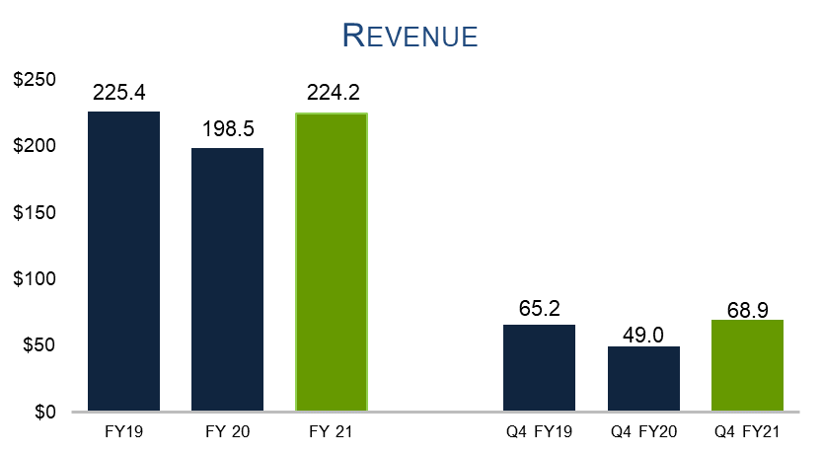
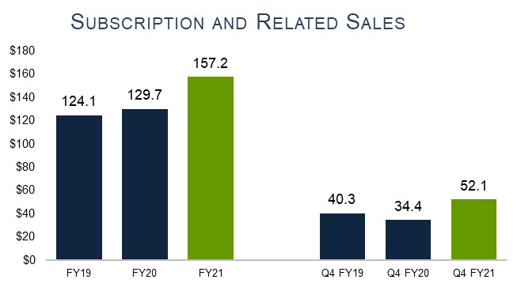
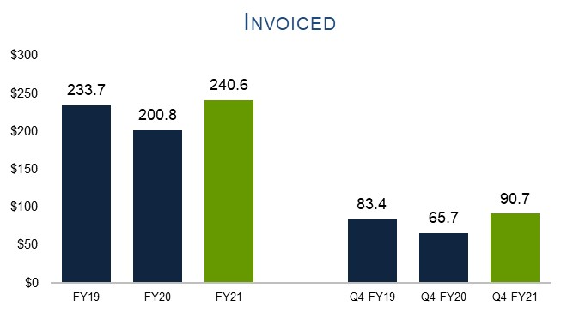

Franklin Covey: Strong Revenue Momentum
(in millions and unaudited)

Slide 30
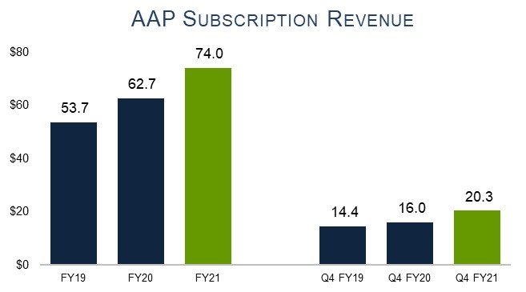
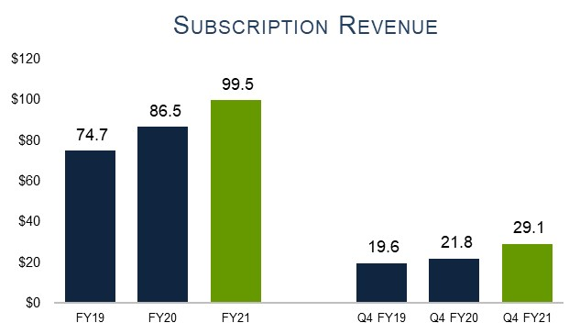
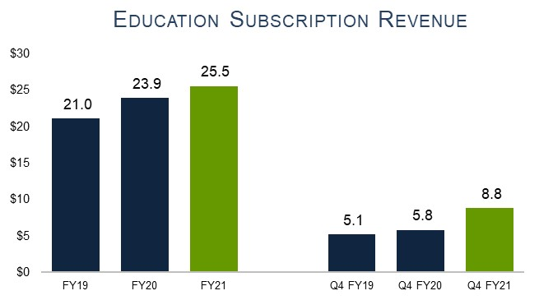
Trends in the Business
(in millions and unaudited)

Slide 31
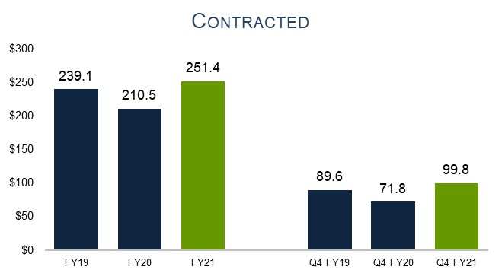
Contracted
(in millions and unaudited)

Slide 32
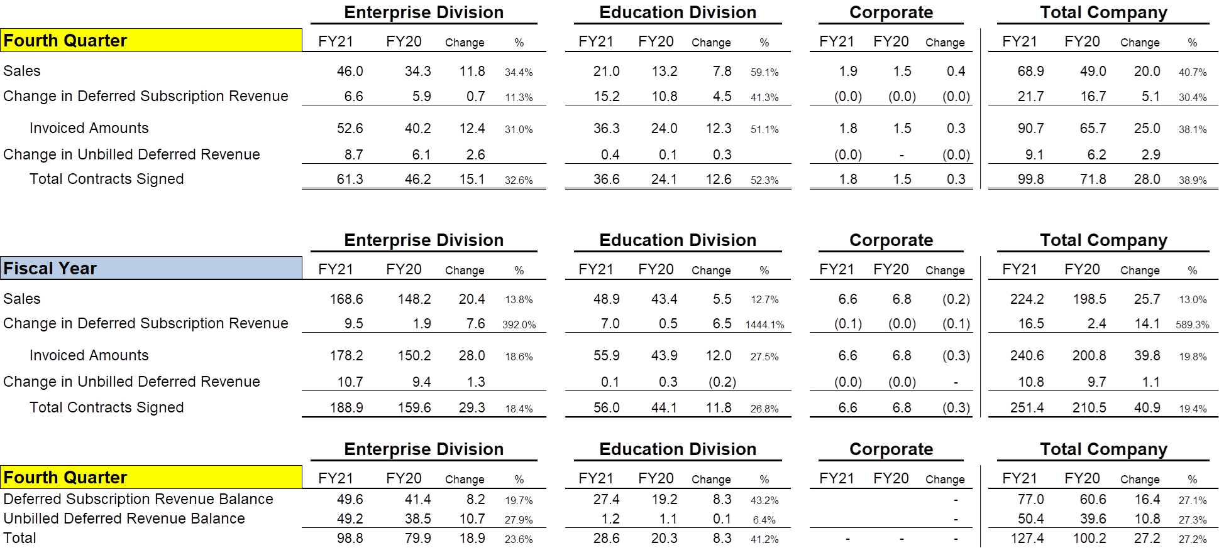
FranklinCovey – Contracts Signed
(in thousands and unaudited)
Notes:
Please compare this information to the Segment Information footnote in Form 10-K.
Please refer to Definitions in the Appendix for the definition of Deferred Revenue and Unbilled Deferred Revenue.
May not total due to rounding.

Slide 33
Sales Information
(in millions and unaudited)
Notes:
Invoiced Amounts represent the amount billed (invoiced) in the period. The Invoiced Amount is equal to Reported Net Sales, plus the associated change in Deferred Subscription Sales on the balance sheet (adjusted for FX). AAP Subscriptions, Education Memberships, and Other Invoiced Subscriptions are all Invoiced Amounts. Unbilled portions of multi-year agreements are not included.
The Difference between Change in Deferred Sales, which is added to Reported Net Sales to equal the Invoiced Amount, and the Change in Deferred Sales on the balance sheet is adjustments for FX, acquisitions and other. Q1 of FY2019 also includes the adjustment attributed to the adoption of Topic 606.
Certain historical amounts have been adjusted to conform with the current presentation.
Deferred Revenue is primarily a current liability. However, a small portion is long-term and recorded as a part of Other Liabilities. See Notes in the 10-K.
Education Subscription Contracts consists of membership subscriptions which is recognized as sales over the course of the contract and Consulting which is recognized as sales upon delivery. These combined performance obligations are contracted, invoiced and paid together. See Deferred Subscription Revenue in the Definitions

Slide 34
Reconciliation of Net Income (Loss) to Adjusted EBITDA
(in thousands and unaudited)
Note: Adjusted EBITDA and Operating SG&A are non-GAAP financial measures. Please see the appendix for additional information.

Slide 35
Additional Financial Information
(in thousands and unaudited)

Slide 36
Condensed Consolidated Balance Sheets
(in thousands and unaudited)

Slide 37
Condensed Consolidated Statements of Operations
(in thousands, except per-share amounts and unaudited)
(1) The term Adjusted EBITDA (earnings before interest, income taxes, depreciation, amortization, stock-based compensation, and certain other items) is a non-GAAP financial measure that the Company believes is useful to investors in evaluating its results. For a reconciliation of this non-GAAP measure to the most comparable GAAP equivalent, refer to the Reconciliation of Net Income (Loss) to Adjusted EBITDA.

Slide 38
Enterprise Division - Financial Summary
(in millions and unaudited)
Note: Adjusted EBITDA and Operating SG&A are non-GAAP financial measures; please see Appendix for additional information. Amounts may not total due to rounding.

Slide 39
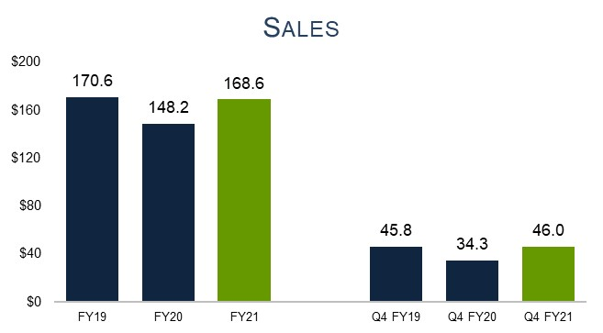
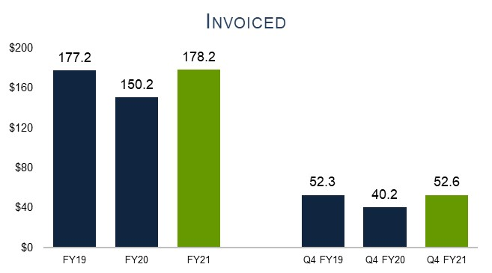
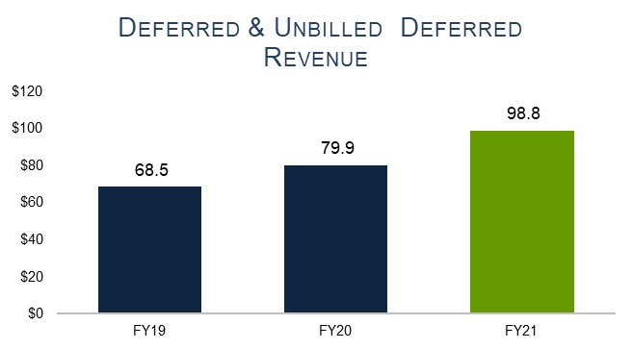
Enterprise Division - Strong Revenue Momentum
(in millions and unaudited)

Slide 40
Enterprise Division - AAP & Related Revenue
(in millions and unaudited)
Other Sales includes China (where AAP is not being offered), book royalties and other miscellaneous revenue items.
Legacy Sales are the sales in areas where AAP is being offered that are not associated with an AAP sale. If a historical Legacy client purchases an AAP, all future facilitator materials or consulting sales from that client are considered to be AAP related.

Slide 41
Education Division - Financial Summary
(in millions and unaudited)
Note: Adjusted EBITDA and Operating SG&A are non-GAAP financial measures; please see Appendix for additional information. Amounts may not total due to rounding.

Slide 42
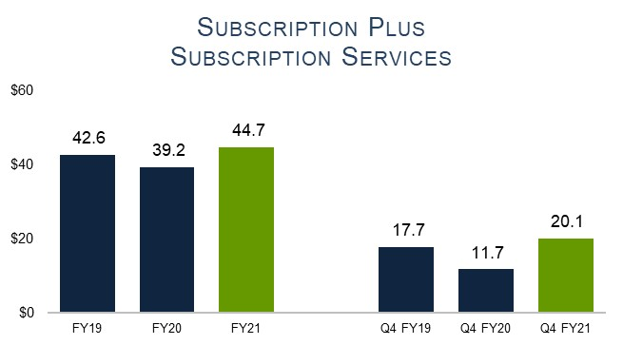
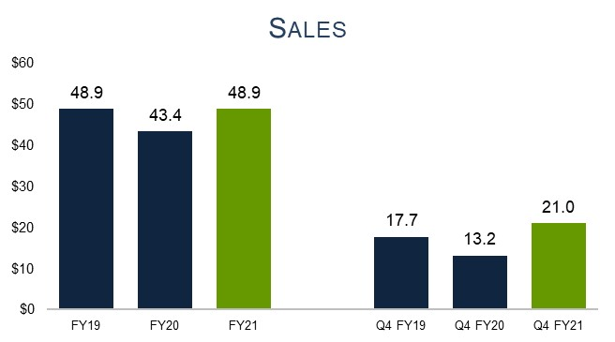
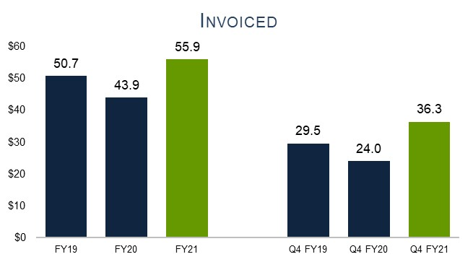
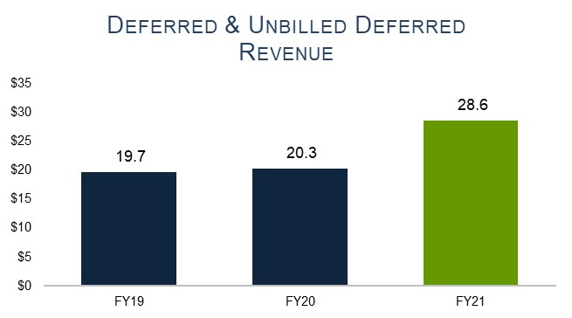
Education Division - Revenue Momentum
(in millions and unaudited)

Slide 43
Number of Client Partners

Slide 44
Definitions
“Deferred Subscription Revenue” primarily consists of billings or payments received in advance of revenue being recognized from subscription services. Deferred revenue is recognized as sales as the revenue recognition criteria are met. The Company generally invoices customers in annual installments upon execution of a contract. With the Leader in Me offering, the contract includes both membership and Onsite consulting which can be invoiced to the client in one lump sum. In this circumstance, the entire lump sum is included in Deferred Revenue. The Education Deferred Revenue related to the LIM is recognized as revenue over the life of the contract whereas the consulting is recognized when the consulting takes place. The deferred revenue balance is influenced by several factors, including seasonality, the compounding effects of renewals, contract duration, invoice timing and contract size. When Management refers to Deferred Revenue or the change in Deferred Revenue it is primarily referring to the subscription related portion and not the customer deposits and other portions.
“Unbilled Deferred Revenue” is an operational measure that represents future billings under our non-cancelable subscription agreements that have not been invoiced and accordingly are not recorded in our recognized revenue or deferred revenue.
“Invoiced” is the sum of reported Net Sales plus the change in Deferred Revenue reported on the balance sheet (a portion of which is recorded as a current liability and a portion as a long-term liability and represents the amount of billings during the period). We typically invoice our customers annually upon execution of the contract or subscription renewals. Our clients frequently prepay for products and services, which prepayment is included in amounts invoiced and corresponding Deferred Revenue. Invoiced amounts does not include items such as deposits that are generally refundable at the client’s request prior to the satisfaction of the performance obligation.
“Contracted” is the sum of Invoiced Amounts plus the Change in Unbilled Deferred Revenue (not recorded on the balance sheet) and, as the term reflects represents, the total amount of contracts with customers that were entered into during the period.
“Sales Flow-Through” is the year-over-year change in Adjusted EBITDA divided by the year-over-year change in sales.
“Add-on Sales” is a sale which has been recognized from a client that has purchased Onsite training or materials in connection with or subsequently to entering into a subscription arrangement. This is in contrast to a Legacy sale which is generally Onsite training or materials for a client which has not entered into a subscription arrangement.

Slide 45
Definitions
“Operating SG&A” is non-GAAP financial measure. It generally excludes stock-based compensation, changes to contingent earn-out liability and unusual or one-time charges. See the Reconciliation of Net Income or Loss to Adjusted EBITDA in additional financial information.
“Adjusted EBITDA” (earnings before interest, income taxes, depreciation, amortization, stock-based compensation, and certain other items) is a non-GAAP financial measure that the Company believes is useful to investors in evaluating its results. A reconciliation of “Adjusted EBITDA,” to consolidated net income (loss), the most comparable GAAP financial measure is provided within this presentation. The Company references this non-GAAP financial measure in its decision making because it provides supplemental information that facilitates consistent internal comparisons to the historical operating performance of prior periods and the Company believes it provides investors with greater transparency to evaluate operational activities and financial results. We are unable to provide a reconciliation of forward-looking estimates of non-GAAP Adjusted EBITDA to GAAP measures because certain information needed to make a reasonable forward-looking estimate is difficult to estimate and dependent on future events which may be uncertain or out of our control, including the amount of AAP contracts invoiced, the number of AAP contracts that are renewed, necessary costs to deliver our offerings such as unanticipated content development costs, and other potential variables. Accordingly, a reconciliation is not available without unreasonable effort.
“Client Partner Ramp” is the expected amount of invoiced amounts the Company expects its client partners to generate based upon the length of time the client partner has been in a sales role. This metric measures client partners who are currently employed by the Company and does not subtract any accounts that are transitioned to a client partner from a previous client partner.
North America revenue consists of revenue generated by our direct offices in the United States and Canada, including government sales.
Constant Currency” Franklin Covey presents constant currency information to provide a framework for assessing how our underlying business performed excluding the effect of foreign currency rate fluctuations. There are several approaches that an entity can take to calculate constant currency information and Franklin Covey’s method may not be consistent with another entity’s constant currency calculation. To calculate this measure, Franklin Covey converts the actual monthly results of our foreign operations, including the results of our International Licenses, into $USD at the respective prior year monthly exchange rate. The non-GAAP measure should not be considered as a substitute for, or superior to, the measures of financial performance prepared in accordance with generally accepted accounting principles (GAAP).

